Slide 1
SPARQL QUERY in BIO2RDF
Big Data in Medical Informatics

Slide 2
BIO2RDF Project
BIO2RDF is an open source framework that makes biological data available on the emerging semantic web using a set of simple conventions.
10 billion triples
29 datasets:
http://download.bio2rdf.org/release/3/release.html
The datasets include interlinked data on genes, proteins, biological models, drugs, gene/protein interactions, genomics, literature etc.
SPARQL 1.1 endpoints using Virtuoso 7.1.0 or Yasgui
http://bio2rdf.org/sparql
http://legacy.yasgui.org/

Slide 3
SPARQL Query variants
SELECT: SQL style result set retrieval. Lets you specify the variables you wish to retrieve from data.
CONSTRUCT: Create a custom RDF graph based on a query criteria. Triples can be extracted verbatim as they exist in the queried triple store or re-constructed to create new RDF data.
ASK: Tests whether the triplestore or graph contains the specified statement. Returns TRUE or FALSE.
DESCRIBE: Returns all the triples that contain a specified resource.

Slide 4
Transforming between vocabularies
Construct a RDF graph from drugbank dataset which outputs some examples of drug interaction.
The result RDF graph is created by taking the results of the equivalent SELECT query and filling in the values of variables that occur in the CONSTRUCT template.
Triples are not created in the result graph for template patterns that involve an unbound variable.
DrugBank Dataset: http://download.bio2rdf.org/release/3/drugbank/drugbank.html
Notes:
The figure of triple architecture helps users to focus on creating the query properly.

Slide 5
Transforming between vocabularies
#comments can be included
PREFIX prefixA: <http://example.org/prefixA#>
PREFIX prefixB: <http://example.org/prefixB:>
CONSTRUCT {
…
}
FROM <http://example.org/myDataset>
WHERE{
……….
}
LIMIT 10

Slide 6
Transforming between vocabularies
Construct a RDF graph from drugbank dataset which outputs some examples of drug interaction.
DrugBank Dataset: http://download.bio2rdf.org/release/3/drugbank/drugbank.html
PREFIX drugbank_vocabulary:<http://bio2rdf.org/drugbank_vocabulary:>
PREFIX rdfs:<http://www.w3.org/2000/01/rdf-schema#>
PREFIX rdf:<http://www.w3.org/1999/02/22-rdf-syntax-ns#>
Instead of returning a table of result values, CONSTRUCT returns an RDF graph
{
?d1 drugbank_vocabulary:ddi-interactor-in ?ddiLink .
}
WHERE { …….. }
CONSTRUCT
Notes:
As explained in the previous slides (set1), result clause can be called in different query variants. One of these is SELECT, which we have explained in details in previous queries.
In this case, we introduce CONSTRUCT, which returns data as RDF graph, not as data table. Under CONSTRUCT clause, we specify triple structure that our data will be returned into.
So, as an input, we expect a RDF graph, specifically obeying the above triple architecture.

Slide 7
Transforming between vocabularies
Construct a RDF graph from drugbank dataset which outputs some examples of drug interaction.
DrugBank Dataset: http://download.bio2rdf.org/release/3/drugbank/drugbank.html
PREFIX drugbank_vocabulary:<http://bio2rdf.org/drugbank_vocabulary:>
PREFIX rdfs:<http://www.w3.org/2000/01/rdf-schema#>
PREFIX rdf:<http://www.w3.org/1999/02/22-rdf-syntax-ns#>
CONSTRUCT {
?d1 drugbank_vocabulary:ddi-interactor-in ?ddiLink .
}
WHERE {
?ddiLink rdf:type drugbank_vocabulary:Drug-Drug-Interaction .
?d1 drugbank_vocabulary:ddi-interactor-in ?ddiLink .
}
LIMIT 500
Notes:
The other parts of the query, we have already studied.

Slide 8
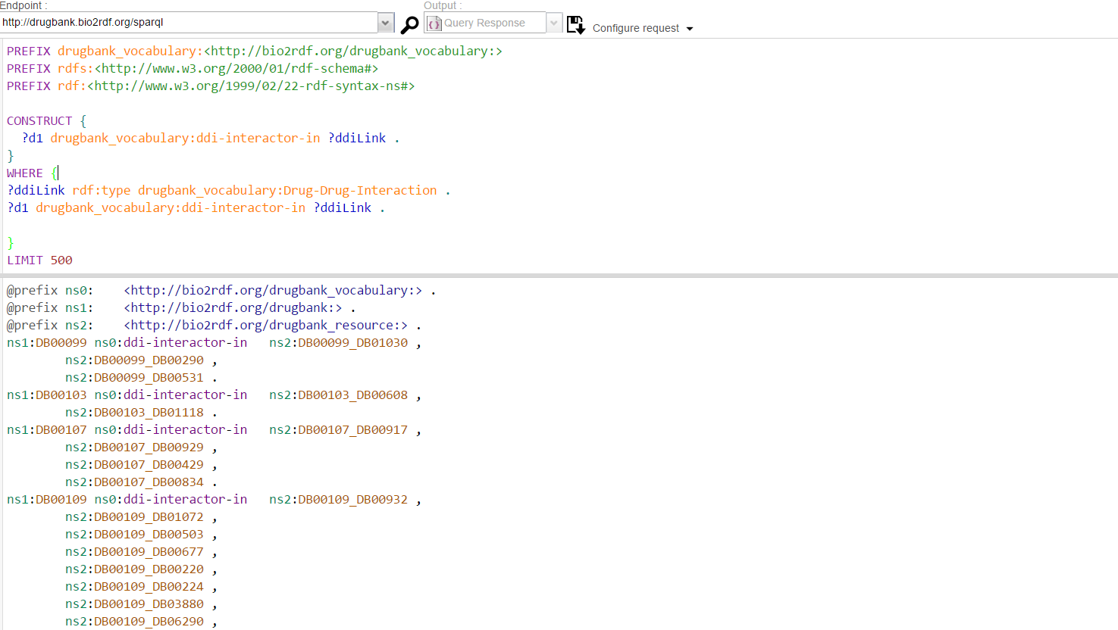
Transforming between vocabularies
Notes:
This is a screenshot of results expected. As we can see, there is an RDF graph displayed, whose elements obey the triple structure we have defined under CONSTRUCT clause.

Slide 9
ASKing a question
Check if two drugs(Alemtuzumab and Pimecrolimus) from the drugbank dataset interact with each other or not.
The ASK result clause simply returns true or false depending on whether or not the query pattern has any matches in the dataset.
The WHERE keyword is optional, not only in ASK queries but in all SPARQL queries.
DrugBank Dataset: http://download.bio2rdf.org/release/3/drugbank/drugbank.html

Slide 10
Transforming between vocabularies
#comments can be included
PREFIX prefixA: <http://example.org/prefixA#>
PREFIX prefixB: <http://example.org/prefixB:>
FROM <http://example.org/myDataset>
ASK
WHERE{
……….
}

Slide 11
ASKing a question
Check if two drugs(Alemtuzumab and Pimecrolimus) from the drugbank dataset interact with each other or not.
DrugBank Dataset: http://download.bio2rdf.org/release/3/drugbank/drugbank.html
PREFIX drugbank_vocabulary:<http://bio2rdf.org/drugbank_vocabulary:>
PREFIX rdfs:<http://www.w3.org/2000/01/rdf-schema#>
PREFIX rdf:<http://www.w3.org/1999/02/22-rdf-syntax-ns#>
returns true or false depending on whether or not the query pattern has any matches in the dataset
WHERE {
?ddi rdf:type drugbank_vocabulary:Drug-Drug-Interaction .
<http://bio2rdf.org/drugbank:DB00087> drugbank_vocabulary:ddi-interactor-in ?ddi .
<http://bio2rdf.org/drugbank:DB00337> drugbank_vocabulary:ddi-interactor-in ?ddi .
}
ASK
Notes:
ASK is another query variant, which returns true or false, depending if the query pattern is satisfied or not. Our intention is to check if those specific drugs interact with each other or not.
We identify these drugs by their drugbank identifier, and check if they create an instance of Drug Drug Interaction .

Slide 12
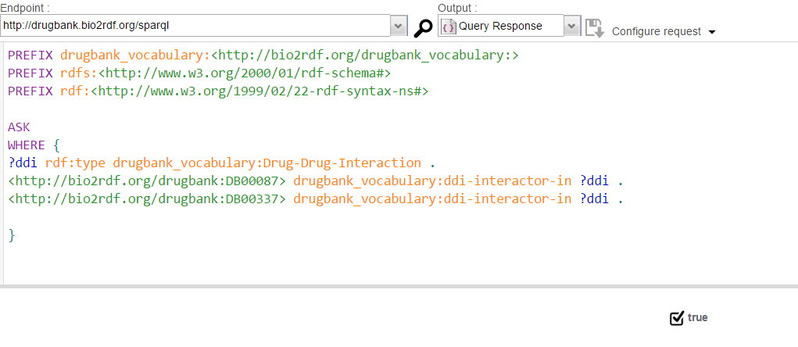
ASKing a question
Check if two drugs(Alemtuzumab and Pimecrolimus) from the drugbank dataset interact with each other or not.
Notes:
In this case, these two drugs interact with each other, so TRUE value is returned.

Slide 13
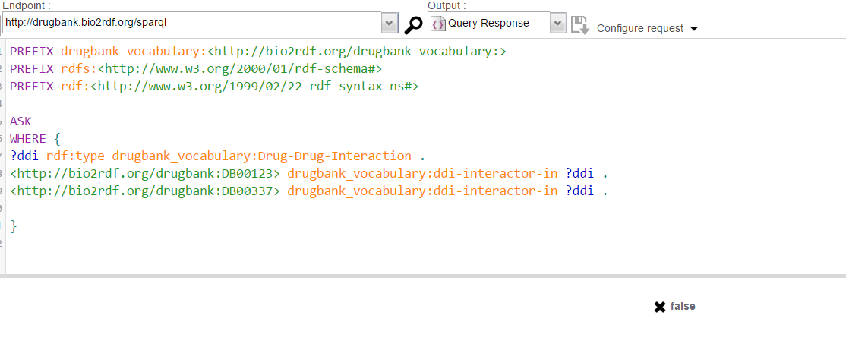
ASKing a question
Notes:
In this case, these two different drugs do not interact with each other, so FALSE value is returned.

Slide 14
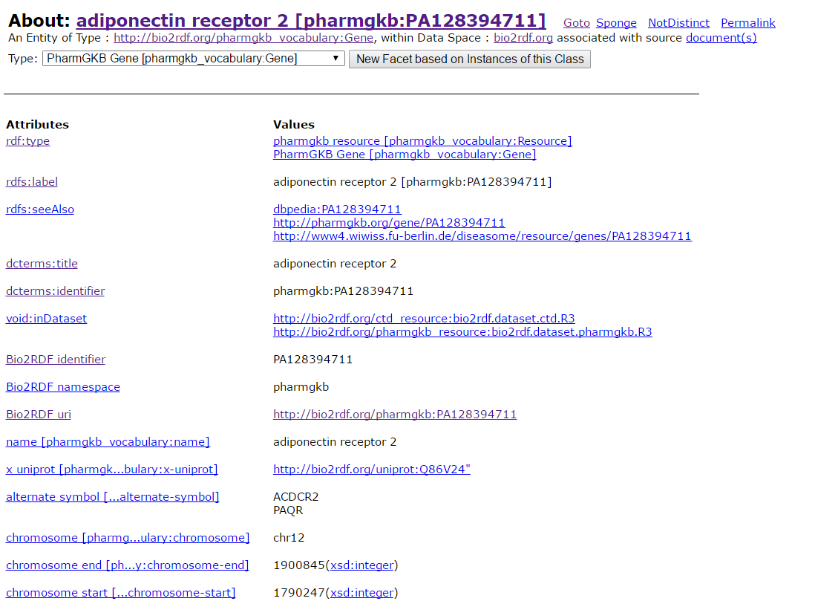
Learning about a resource
Tell me whatever you can about gene adiponectin receptor 2 [pharmgkb:PA128394711].
http://bio2rdf.org/describe/?uri=http://bio2rdf.org/pharmgkb:PA128394711
Notes:
In this link, we can find features of adiponectin receptor 2 gene represented in pharmkgb dataset. Our purpose is to return everything possible about it, in a more machine readable way.

Slide 15
Learning about a resource
DESCRIBE query result clause allows the server to return whatever RDF it wants that describes the given resources.
Because the server is free to interpret DESCRIBE as it sees fit, DESCRIBE queries are not interoperable.
Common implementations include concise-bounded descriptions, named graphs, minimum self-contained graphs etc.

Slide 16
Learning about a resource
#comments can be included
PREFIX prefixA: <http://example.org/prefixA#>
PREFIX prefixB: <http://example.org/prefixB:>
FROM <http://example.org/myDataset>
DESCRIBE <http://example.org/prefixB:123456>

Slide 17
Learning about a resource
Tell me whatever you can about gene adiponectin receptor 2 [pharmgkb:PA128394711].
PREFIX pharmgkb: <http://bio2rdf.org/pharmgkb:>
pharmgkb:PA128394711
allows the server to return whatever RDF it wants that describes the given resources
DESCRIBE
http://bio2rdf.org/describe/?uri=http://bio2rdf.org/pharmgkb:PA128394711
Notes:
DESCRIBE is another query variant, which allows the server to return whatever RDF resource available in the dataset. In our specific case, we need to display information about the gene identified by PA128394711 id.

Slide 18
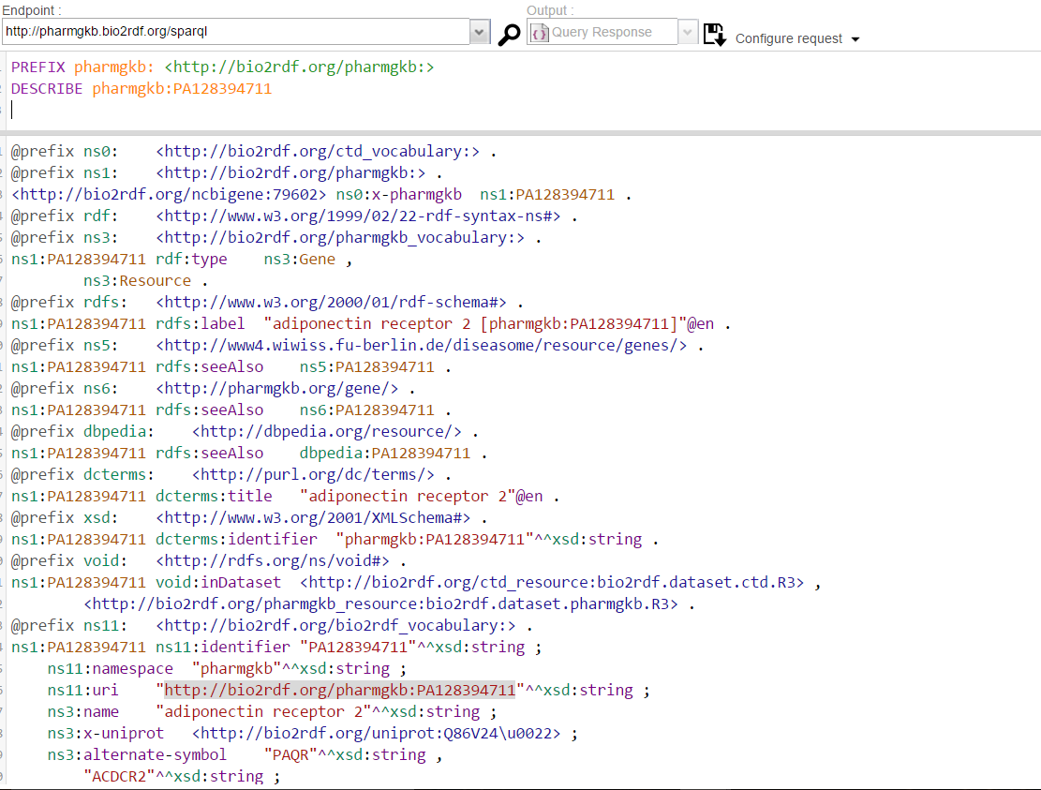
Learning about a resource
Notes:
This is an example of using DESCRIBE query variant.

